Slide 1
Faster testing with Kotlin. Android case.
Justinas Krutulis
justinas.krutulis@gmail.com

Slide 2
Agenda
We should write code for humans not to computers. Clean code. Expressive. Fewer lines, that does same thing.
Clean code
Clean architecture
Kotlin
Koin

Slide 3
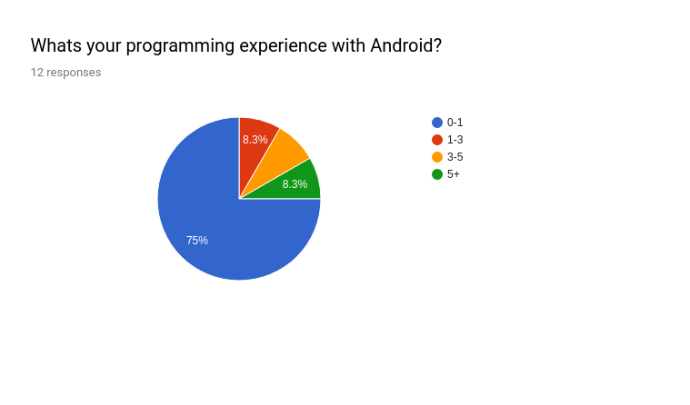

Slide 4
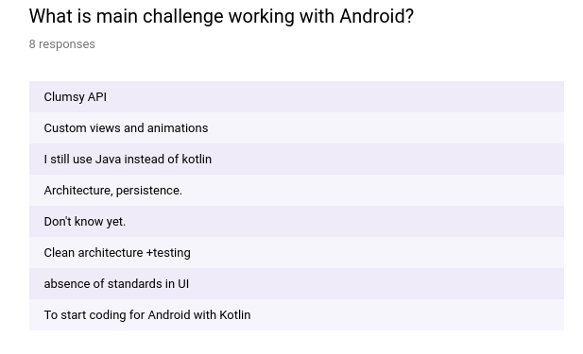

Slide 5
What would be interesting to know about Kotlin?
Examples?
Is it better?
Could it be used in backend? Thor. https://kotlin.link/. Kotlin spring
IDEA support?

Slide 6
What would be interesting to know about MVVM?
Examples?
What to choose?

Slide 7

Kiss

Slide 8
Kiss Agenda
Commercial for
Kotlin, Koin, MVVM testing, couse it works and it’s cool
Commercial for movie “Pentagon wars” if we will have time

Slide 9
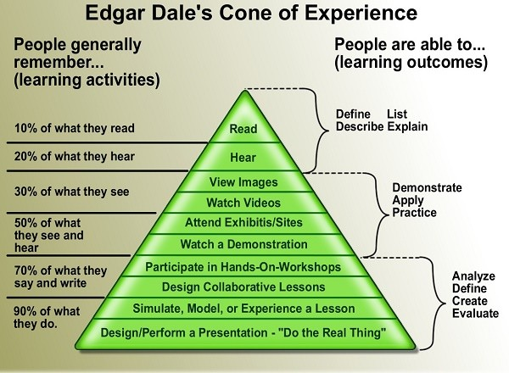
Notes:
People Remember 10 Percent of What They Read

Slide 10

Clean code
Helps to clear the thoughts, intent, tests
Takes time, refactoring, effort to separate dependencies, extra work.
Ref: https://www.planetgeek.ch/wp-content/uploads/2014/11/Clean-Code-V2.4.pdf

Slide 11
MVVM
1 UI components are separated from business logic
2 Business logic is separated from Database
3 Easy to understand and read
4 A lot of less to worry about lifecycle

Slide 12
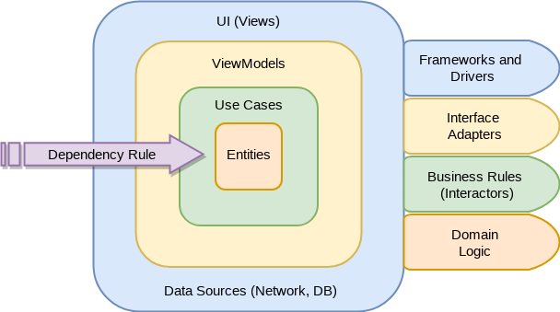
Clean architecture MVVM
Ref: https://github.com/android10/Android-CleanArchitecture-Kotlin

Slide 13
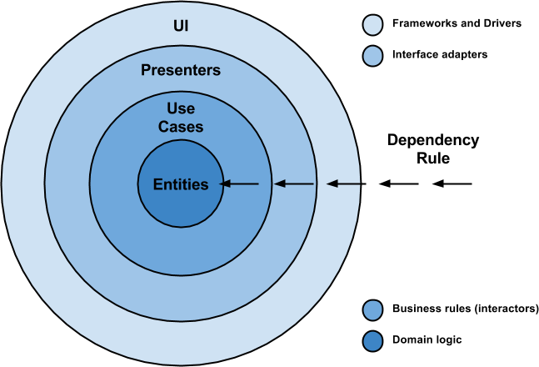
Clean architecture MVP
Ref: https://github.com/android10/Android-CleanArchitecture

Slide 14
MVVM vs MVP.

Slide 15
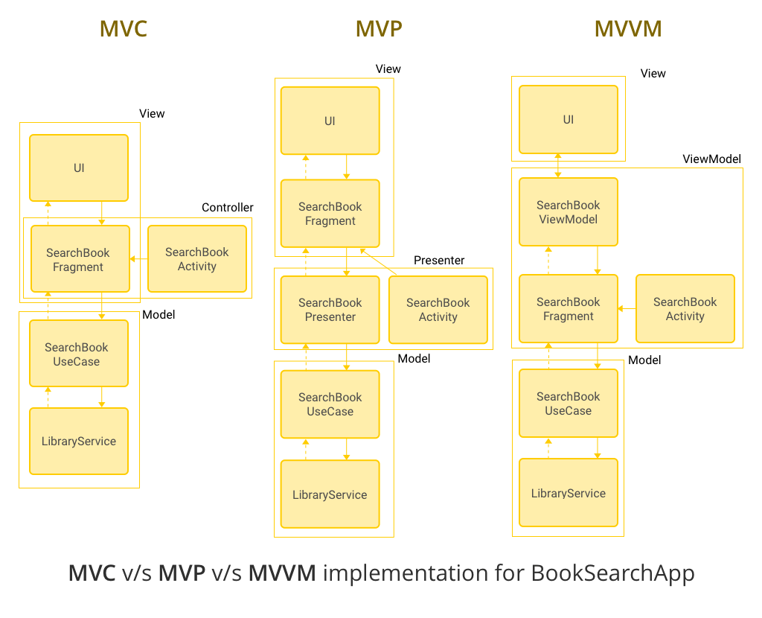
MVVM vs MVP vs MVC
https://www.simform.com/mvc-mvp-mvvm-android-app-development/

Slide 16
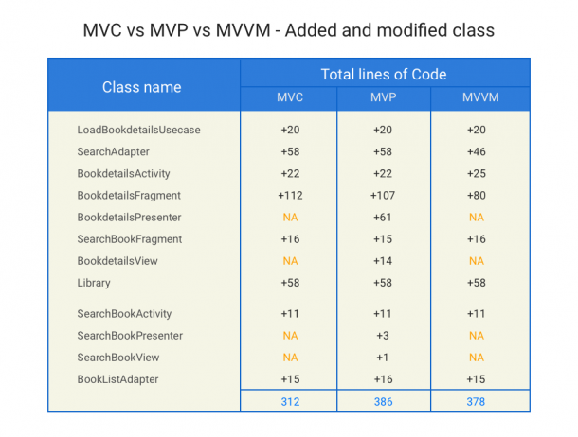
MVVM

Slide 17
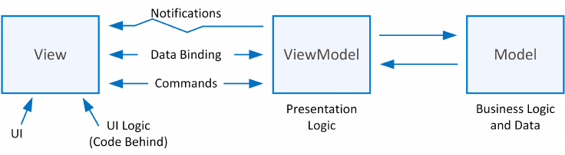
MVVM

Slide 18

Contradiction

Slide 19
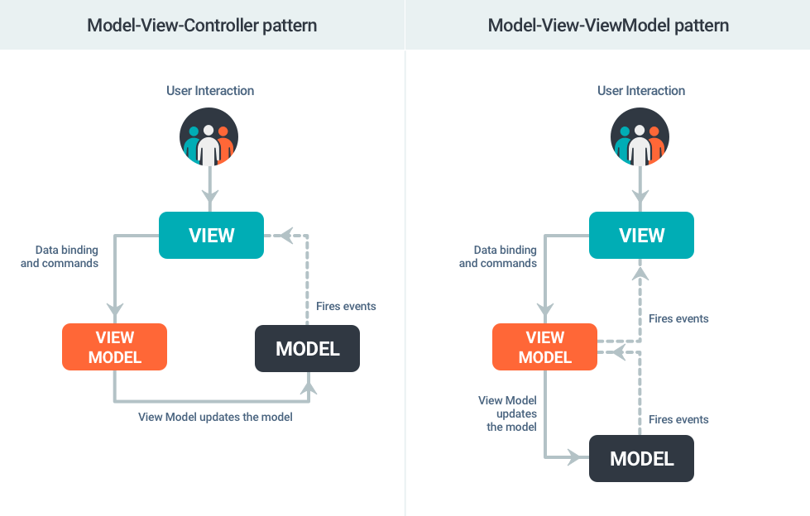
Contradiction

Slide 20
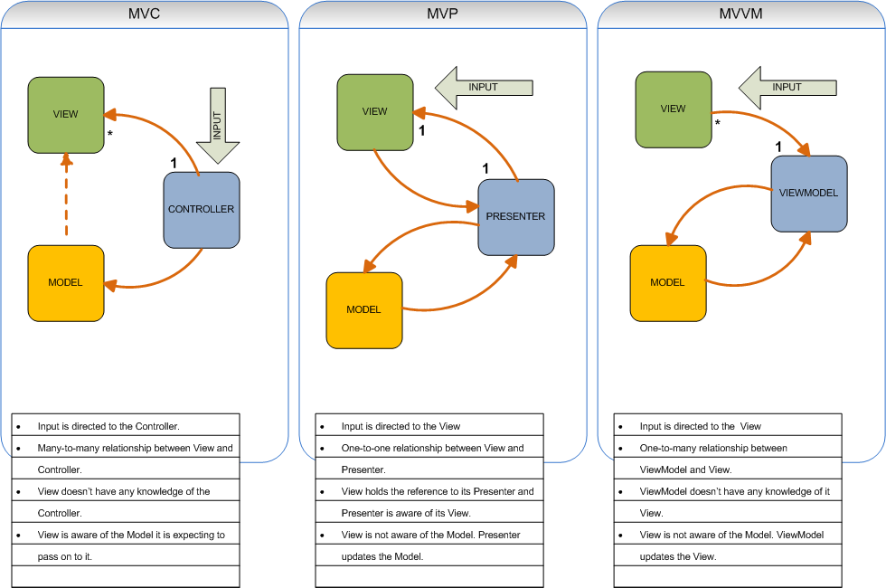

Slide 21
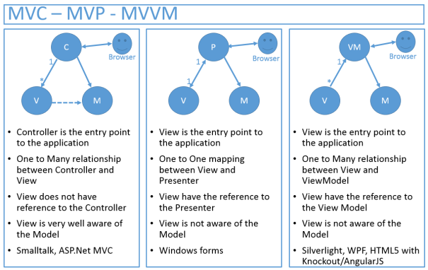
MVVM vs MVP vs MVC

Slide 22
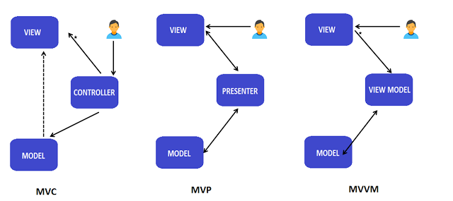
MVVM vs MVP vs MVC KISS

Slide 23
Why MVVM?
Official by android with androidx (jetpack)
Easy to seperate and test
Less interfaces, less code

Slide 24
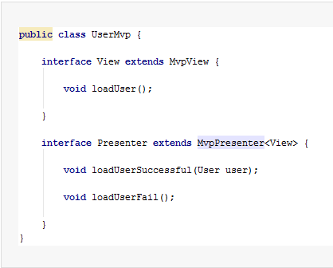
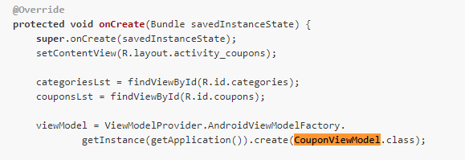
MVVM vs MVP. from codebase

Slide 25
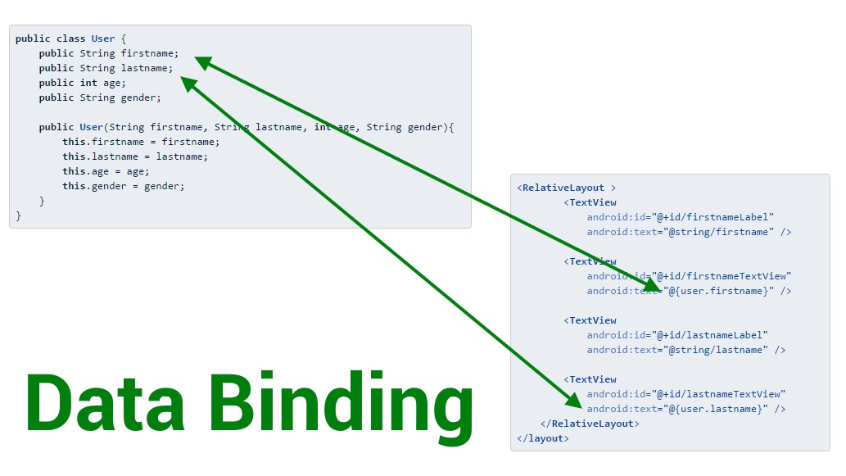
Databinding

Slide 26
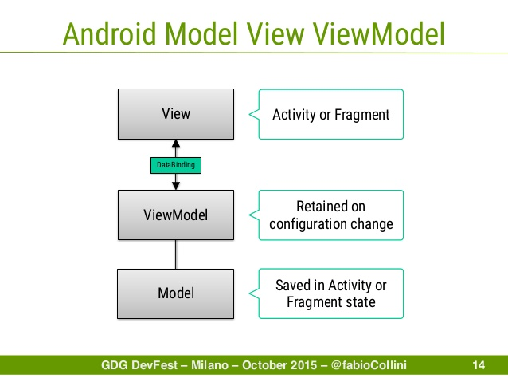
MVVM officially supported by androidx and Databinding

Slide 27

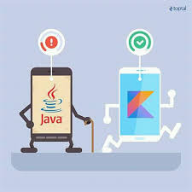
Kotlin official from 2017

Slide 28


2019
?
https://medium.freecodecamp.org/https-medium-com-rahman-sameeha-whats-flutter-an-intro-to-dart-6fc42ba7c4a3

Slide 29
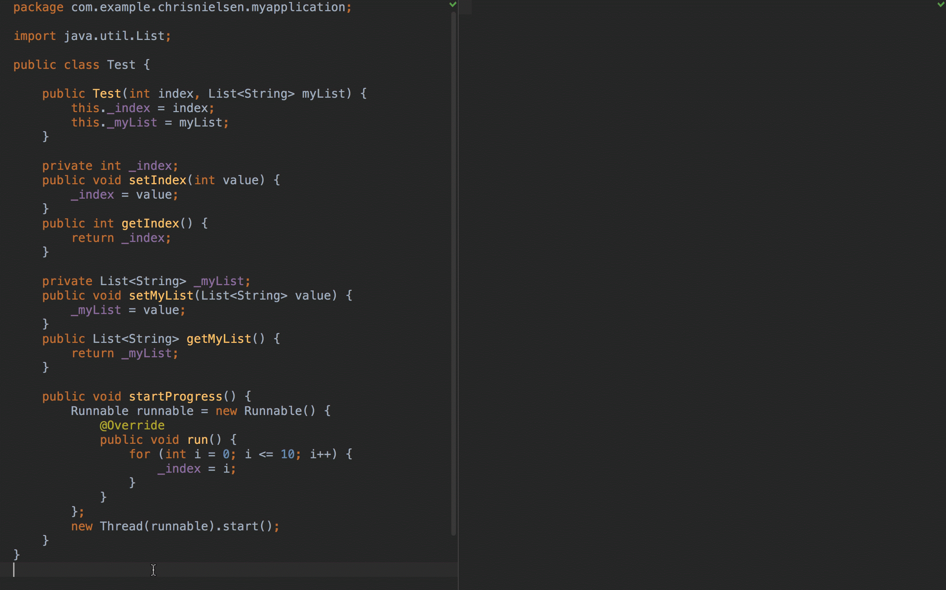

Slide 30
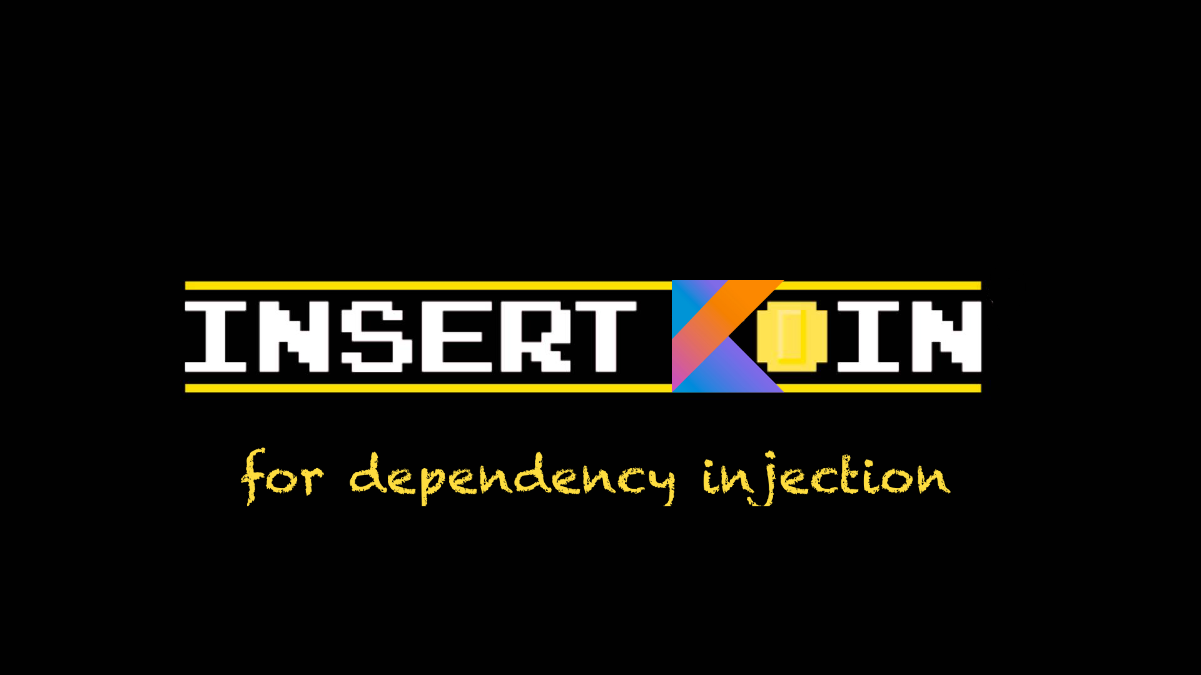
https://insert-koin.io/

Slide 31
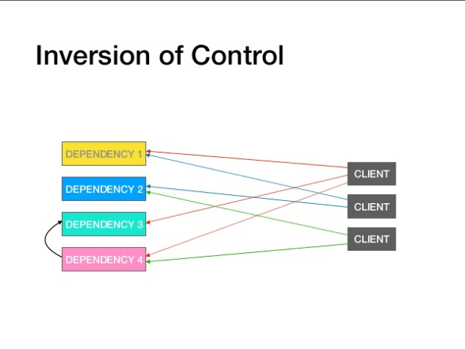

Slide 32
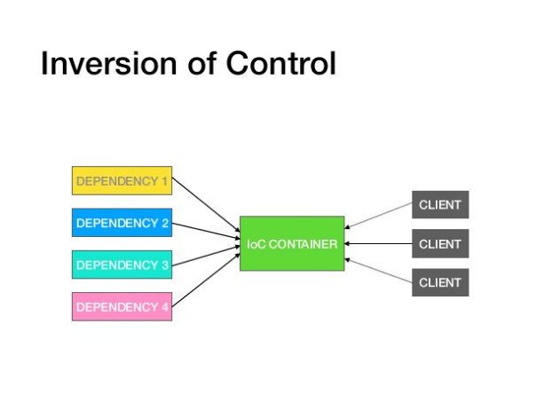
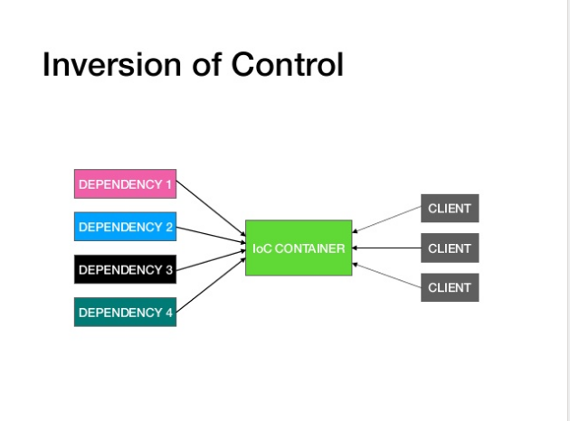
https://www.slideshare.net/ssuser80beb5/koin-for-dependency-injection

Slide 33
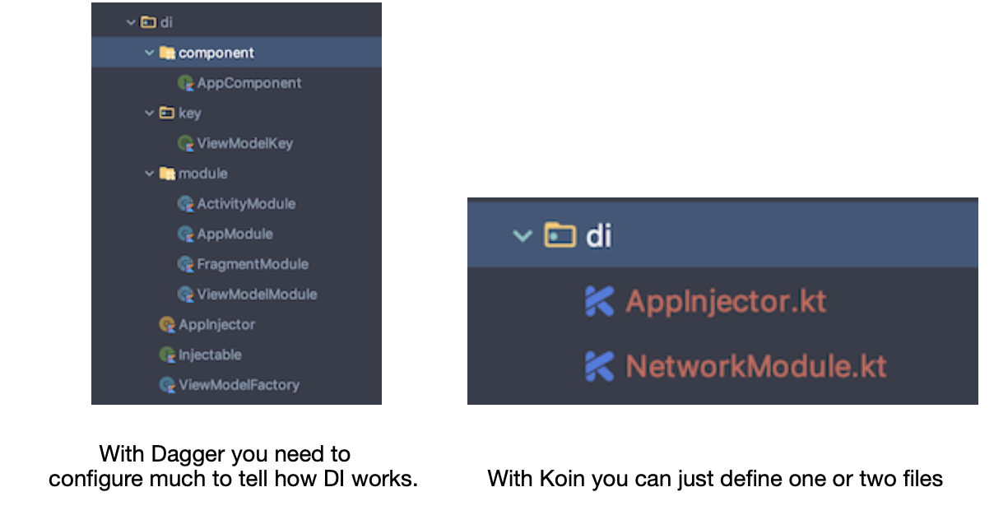
Koin vs Dagger

Slide 34
How to write test Faster and Easier?

Slide 35
Less code, less code to read, misinterpreted and less to unit test
KISS
Clean code
Clean architecture MVVM + Single Activity
Databinding + LiveData
Kotlin + RxJava/Coroutines
Koin

Slide 36
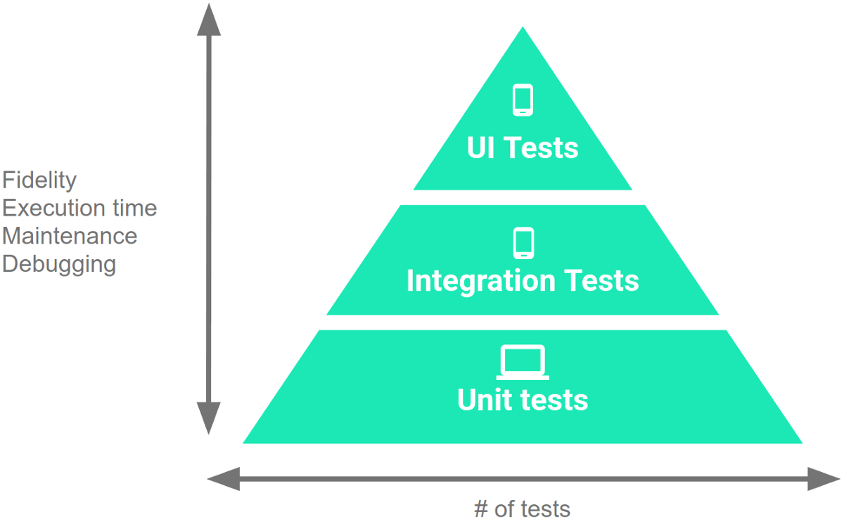
Testing

Slide 37
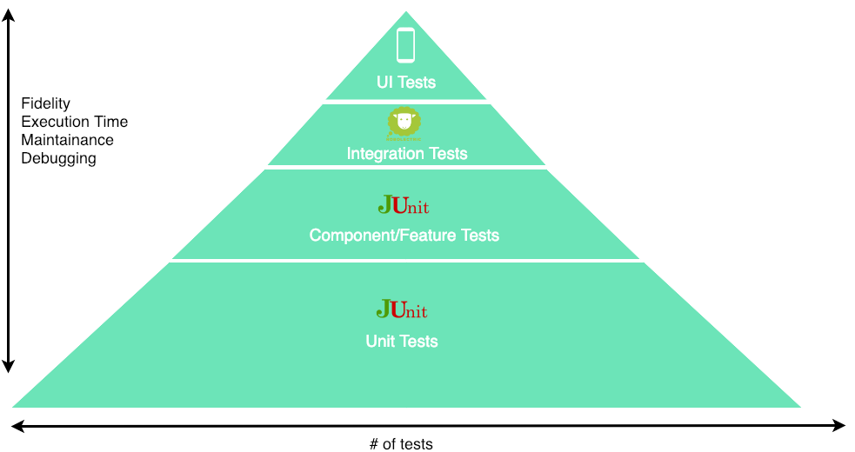
Writing less “Instrumental tests”
https://proandroiddev.com/writing-integration-tests-in-android-b0436978ed7b

Slide 38
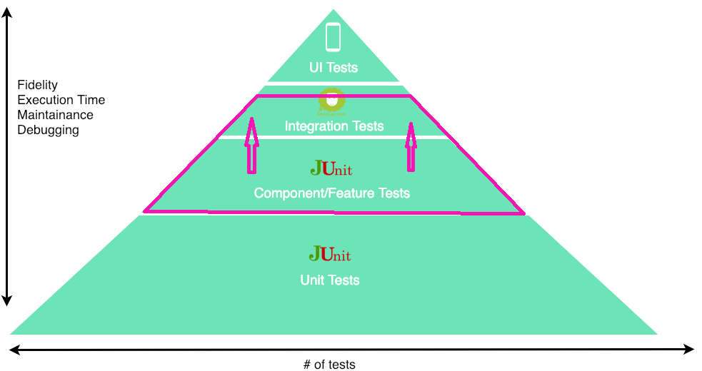
Writing even less “Instrumental tests”

Slide 39
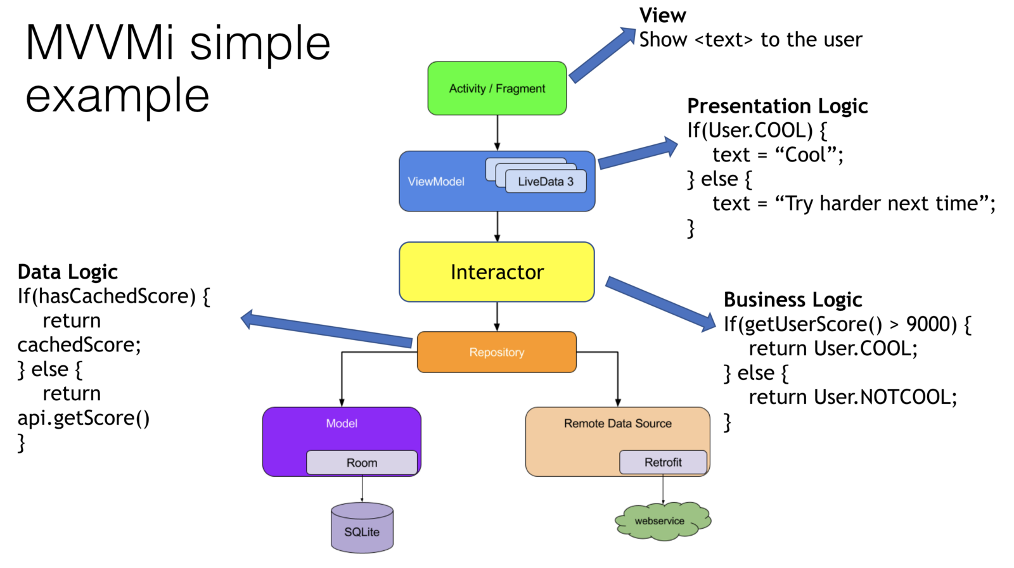
Actual implementation

Slide 40
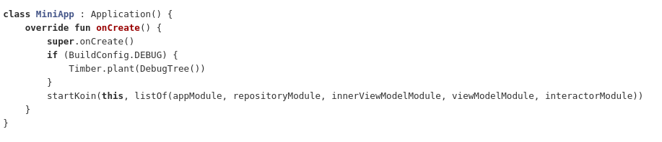
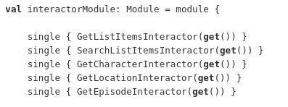
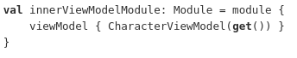

Slide 41
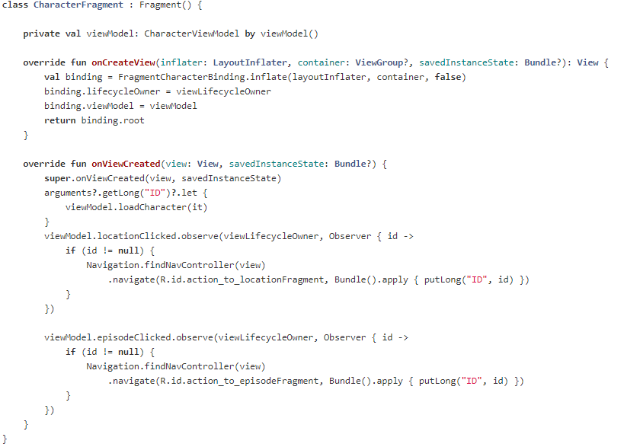
Single activity. Many fragments

Slide 42
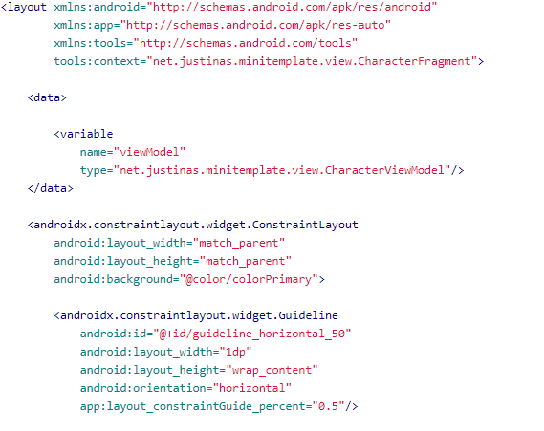
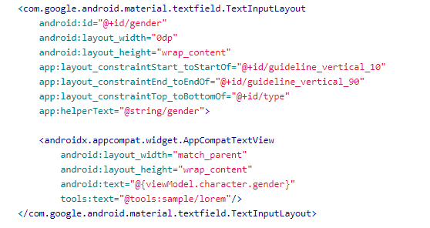

Slide 43
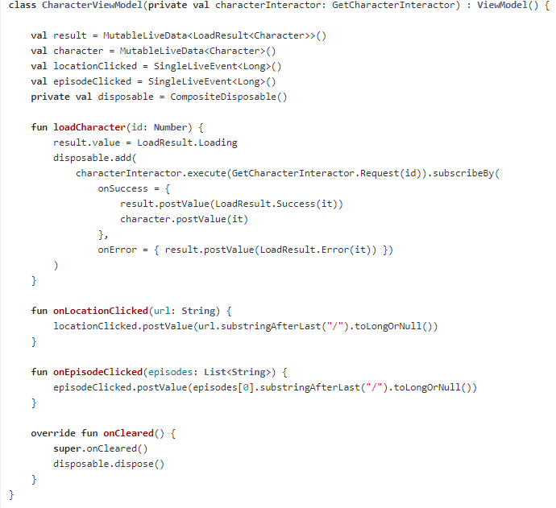

Slide 44
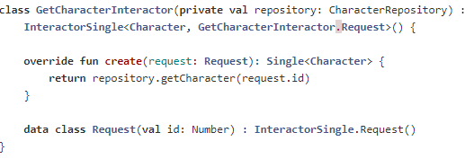
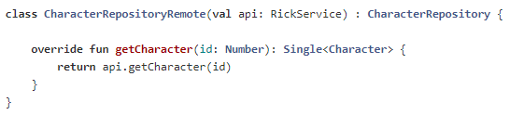
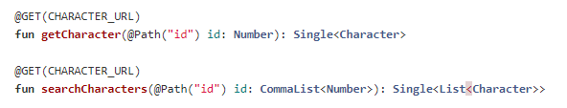

Slide 45
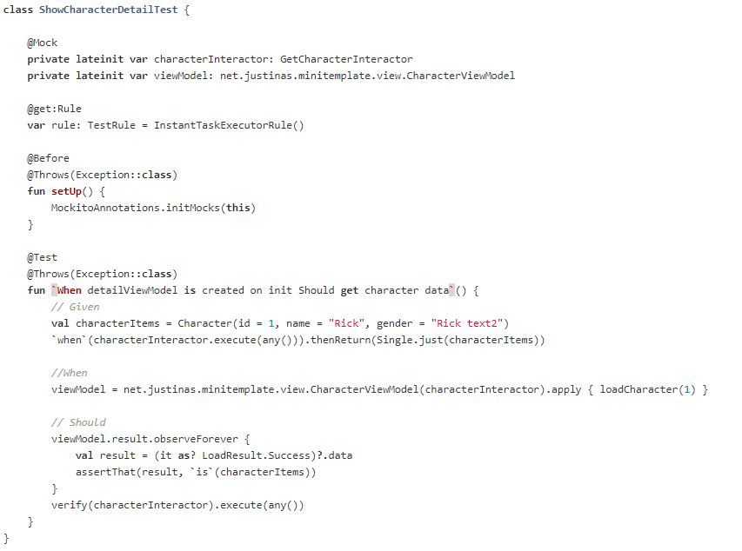

Slide 46
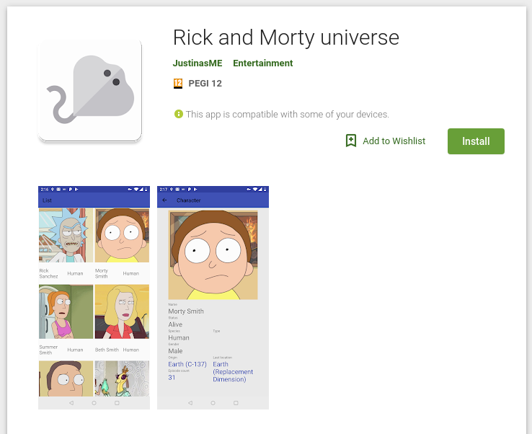
Demo
https://play.google.com/store/apps/details?id=net.justinas.minitemplate
https://gitlab.com/dzastinas/mini-list

Slide 47

Why even the best architecture in the world will not help (Full movie in Youtube)

Slide 48

Communication

